Slide 1
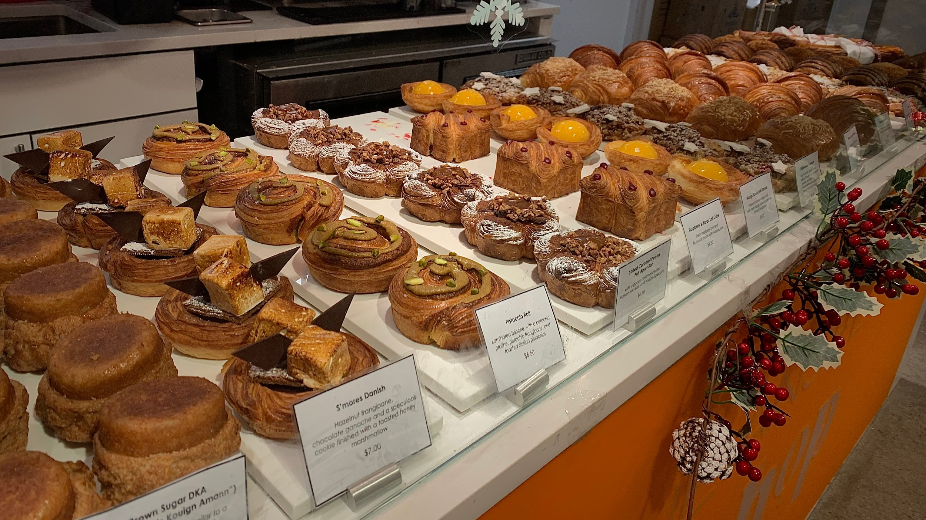
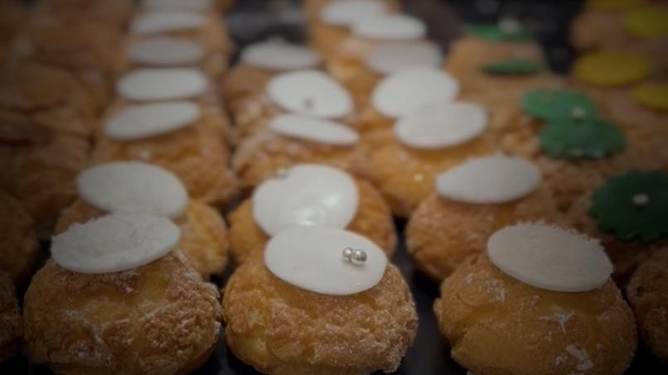
The Aesthetics and Consumption
of French Pastries:
A Cultural and Historical Account of Pâtisserie in Paris
Kate Wunderlich
Dr. Leyla Savloff, Department of Sociology and Anthropology

Slide 2
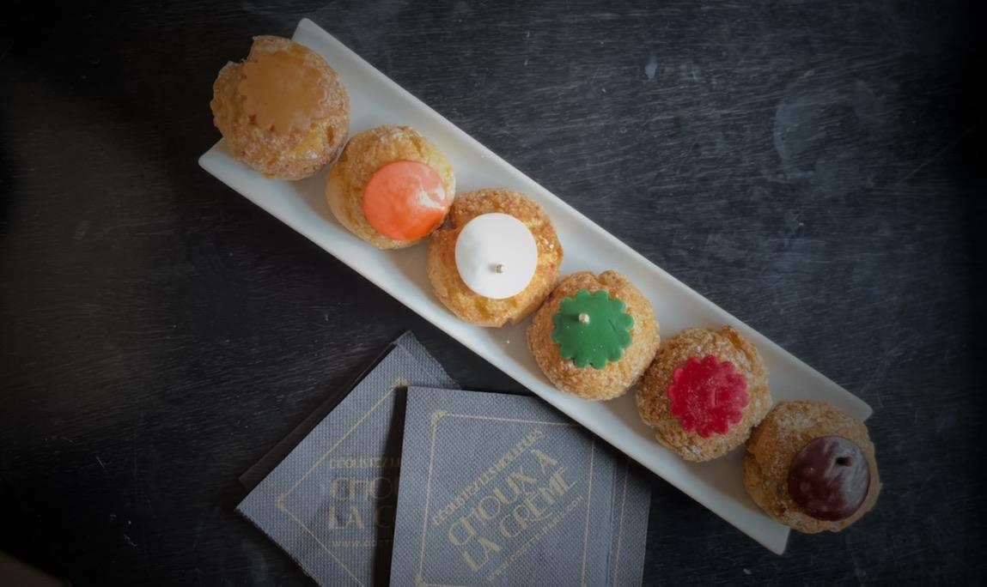
01
History of Cuisine and National Values in France

Slide 3
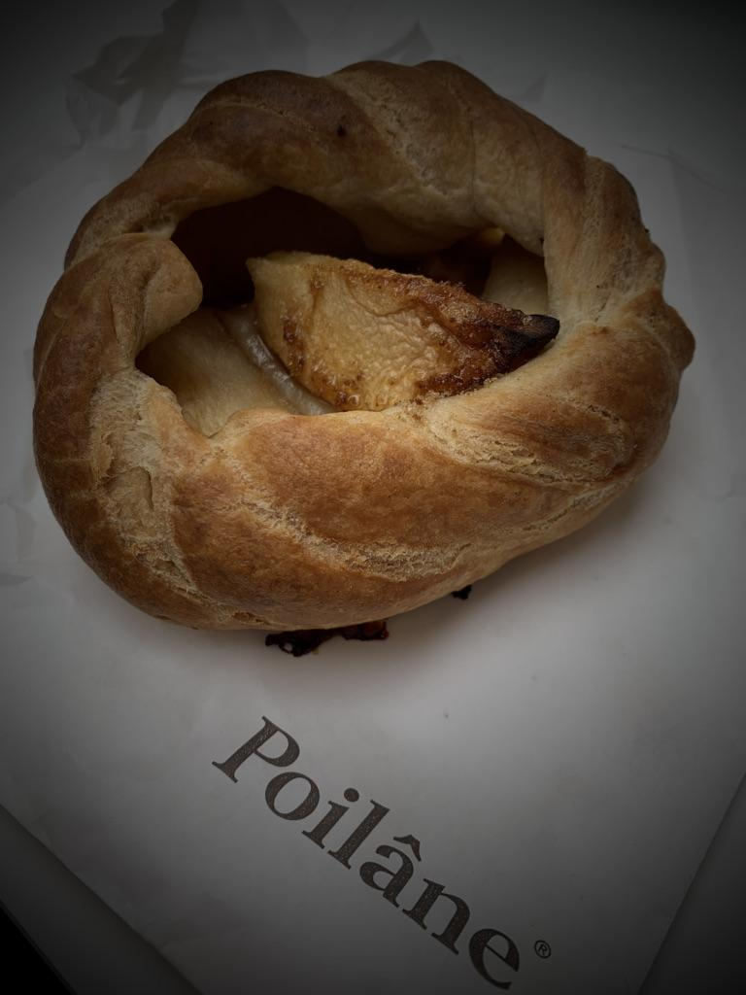
National Identity
Tradition
French Values
Authenticity
Textualization and Tour of France
Terroir
Shared experiences
Pastries are shared
Three factors
Cultural pride
(Wheaton 1996)

Slide 4
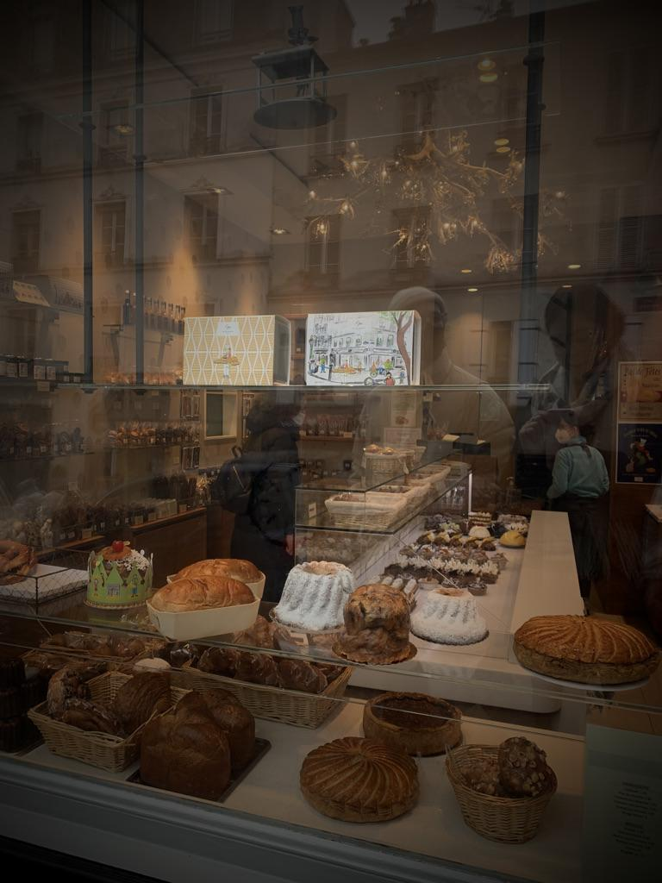
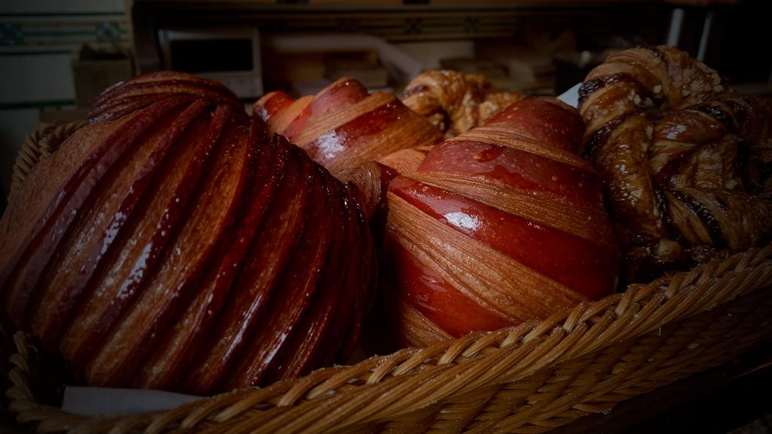
02
Theory on Globalization and National Values in the United States

Slide 5
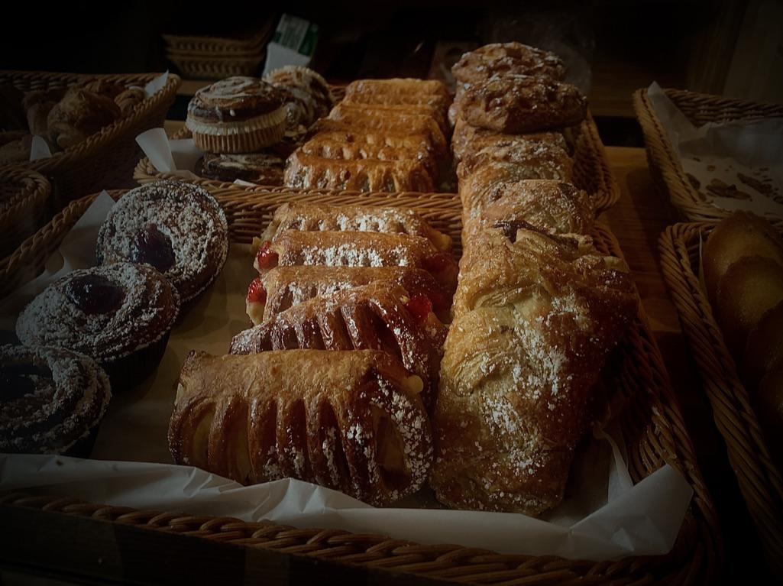
United States Values
Capitalism
Consumerism
Innovation
Post-WWII America experienced economic prosperity and productivity
U.S. involvement in European politics caused resistance to European ideals
New Wave Capitalism
Period of productivity followed by unrest caused the questioning of new wave capitalism
Neoliberalism stressed free markets and reduced state’s role in economy
Post Cold War and Iraq involvement opened the world to capitalistic investment
Global free market with an American template
(Gordon & Meunier 2001)

Slide 6
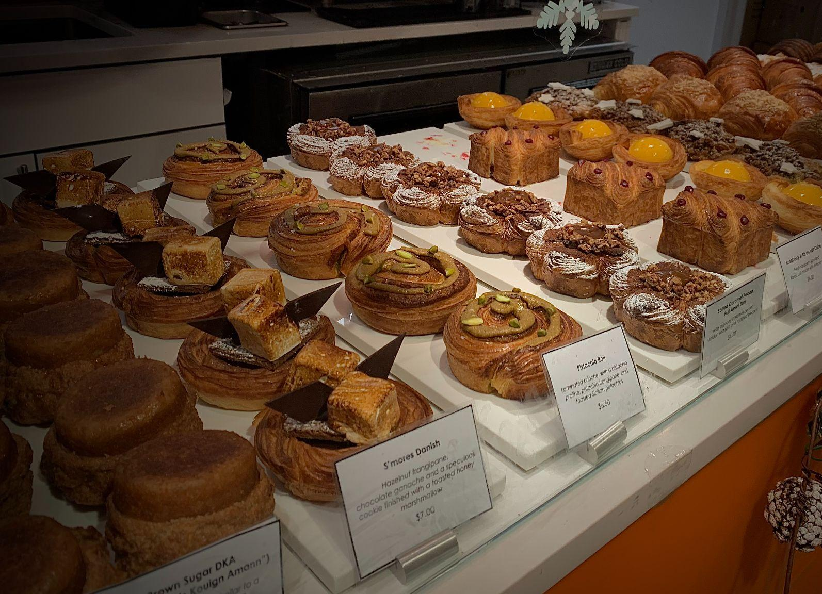
Americanization and French Resistance
Post-World War II
José Bové
Policy Changes
(Gordon & Meunier 2001)

Slide 7

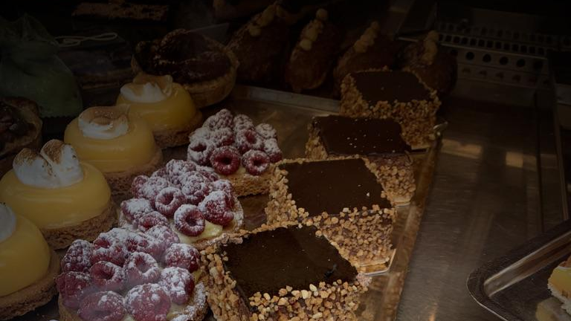
Ethnography and Examples
03

Slide 8
Methodology
Phase 1: Literary Analysis
Phase 2:
Ethnographic Observation and Semi-
Structured Interviews
Phase 3: Survey Collection and Synthesis of Data
(Gordon & Meunier 2001)

Slide 9
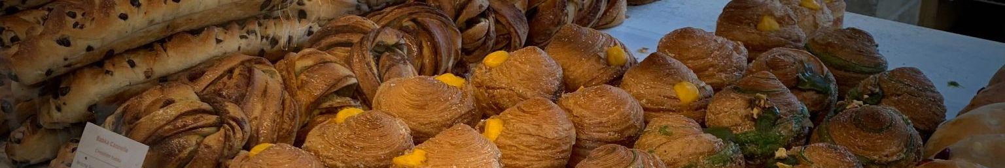
Types of Pâtisseries in France
01
02
03
Traditional
Combination
Specialty
Only traditional pastries are offered. Typically neighborhood/locally-owned pâtisseries.
Offers both traditional pastries and a new specialty pastry. Typically more rare than Type 1.
Offers only one type of specialty pastry. Typically accompanied by a display window into the kitchen.

Slide 10
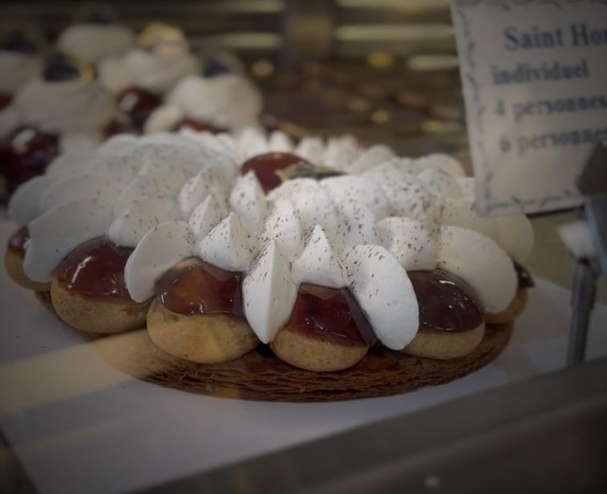
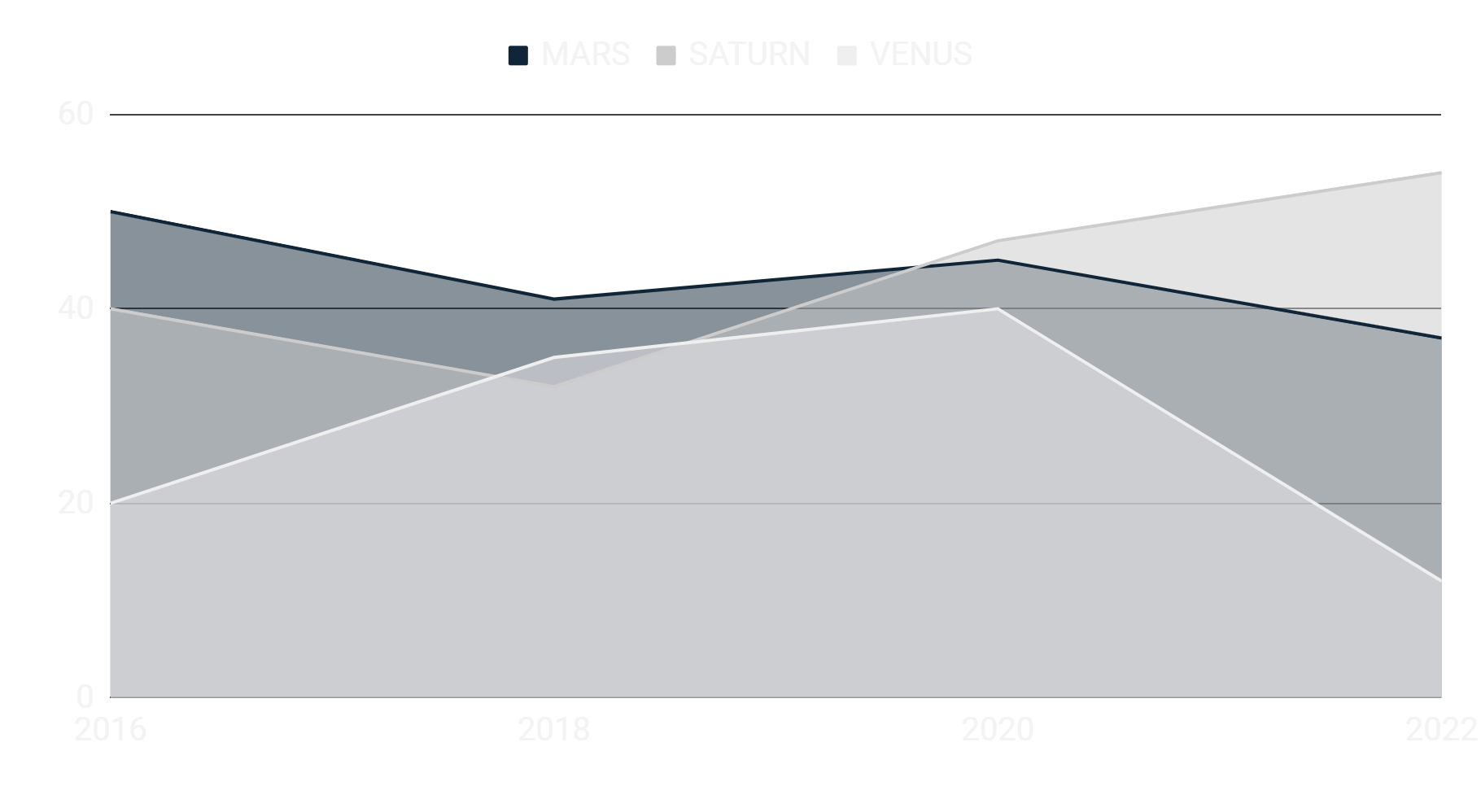
Traditional
If you want to modify this graph, click on it, follow the link, change the data and replace it

Slide 11
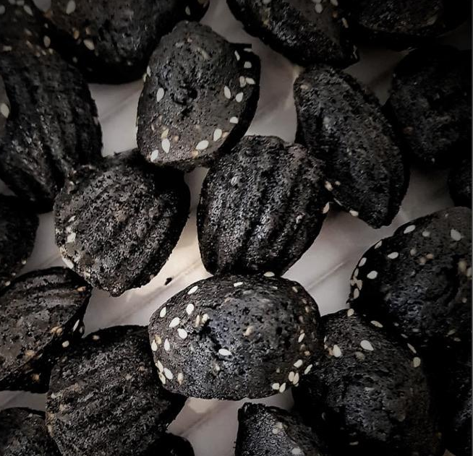
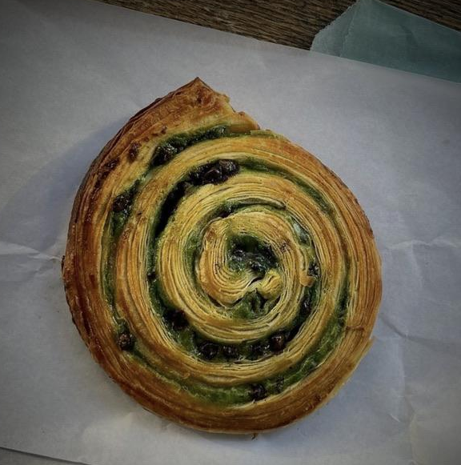
Combination
Boulangerie Utopie
Du Pain et des Idées

Slide 12
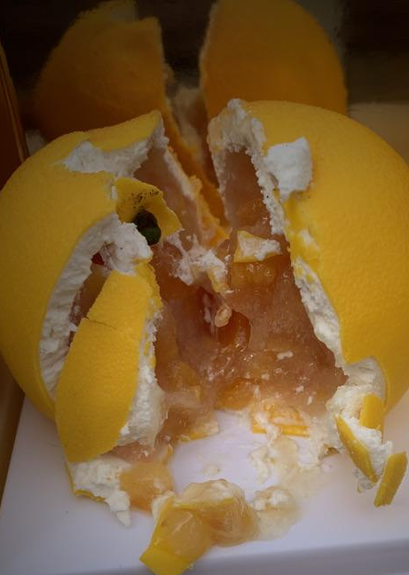
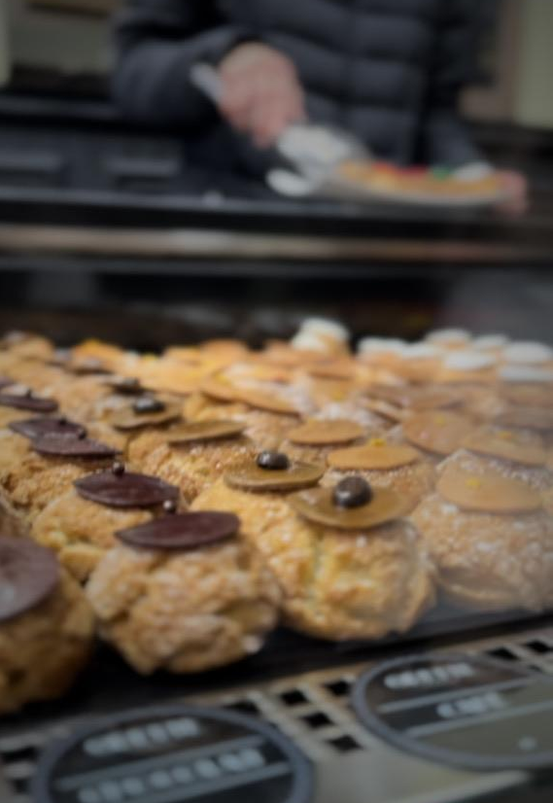
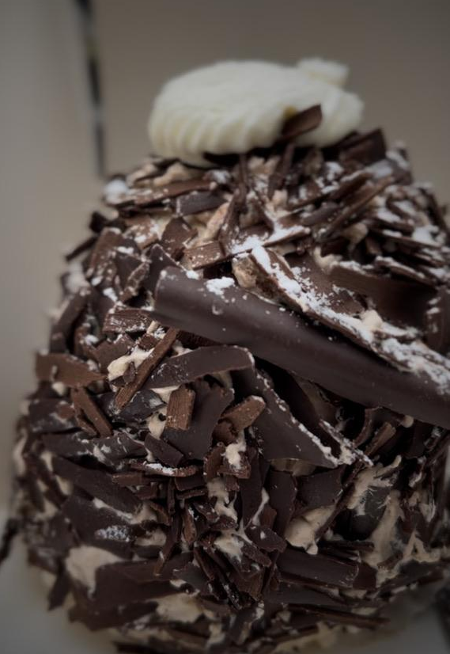
Specialty
Cedric Grolet
Fred’s Merveilleux
Odette
=

Slide 13
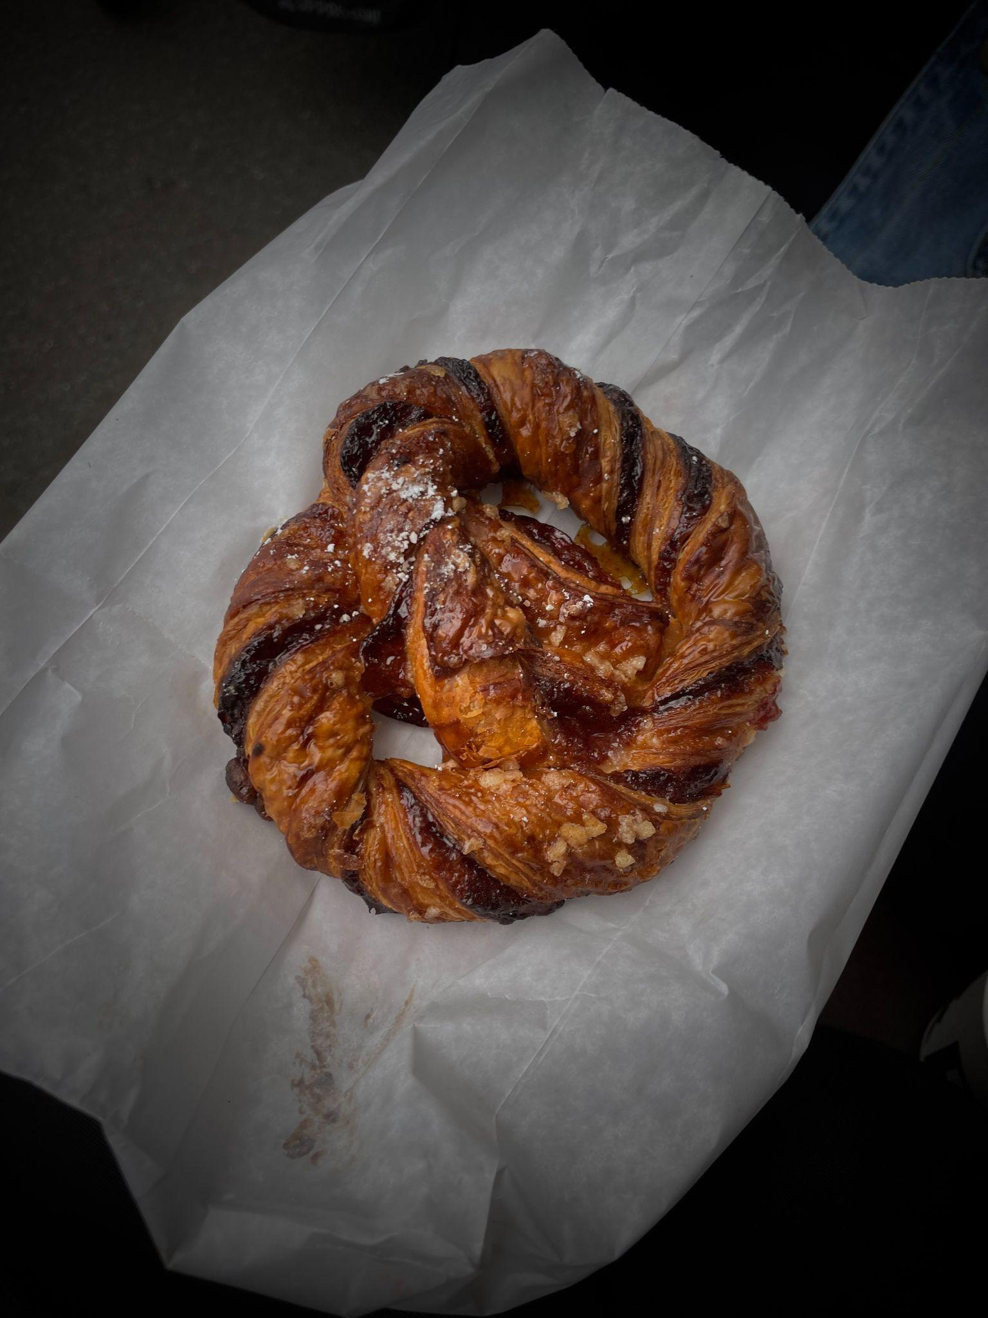
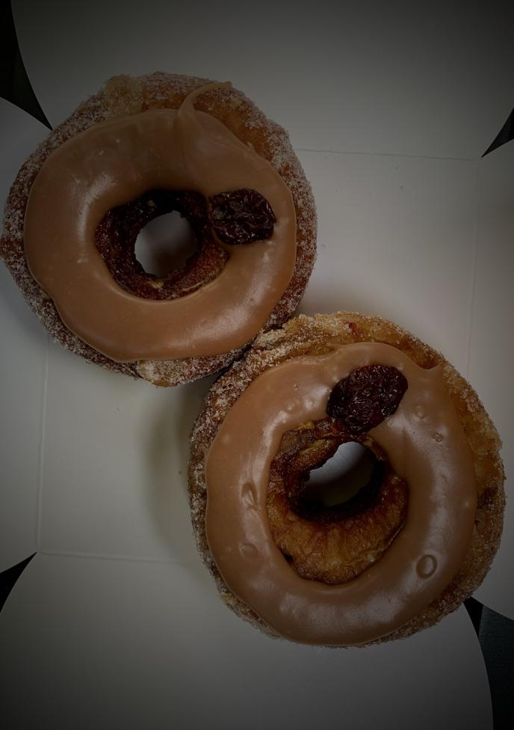
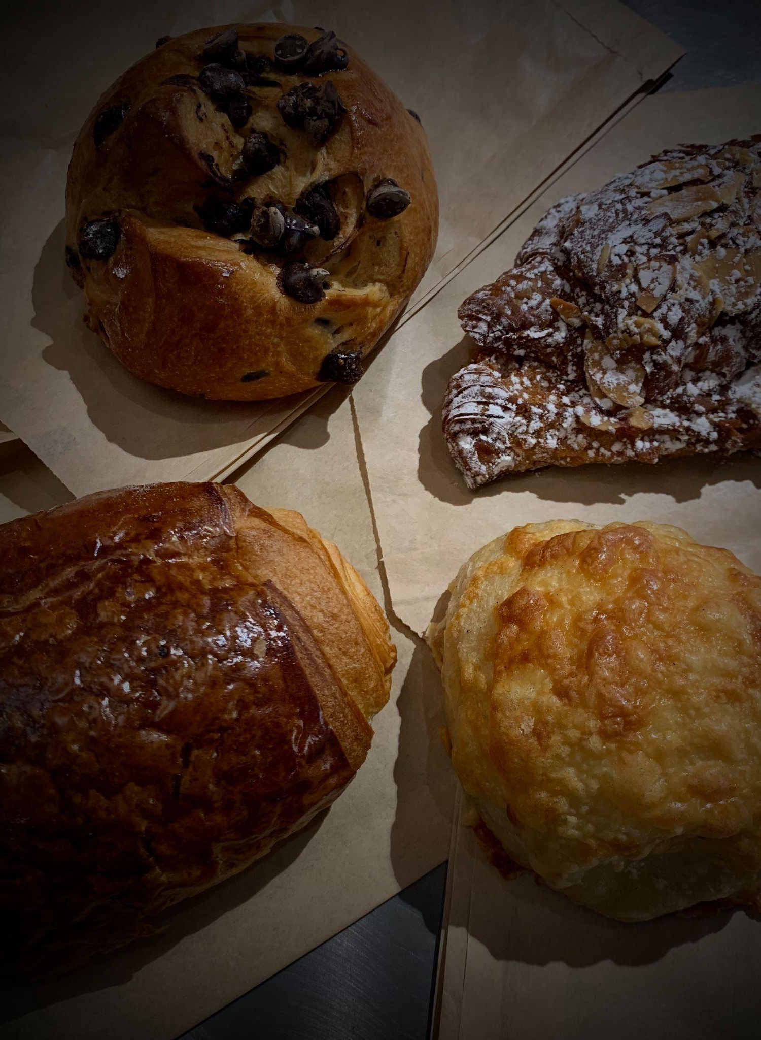
Pâtisseries in New York City
Le Fournil
Dominique Ansel Bakery
Bread Story

Slide 14

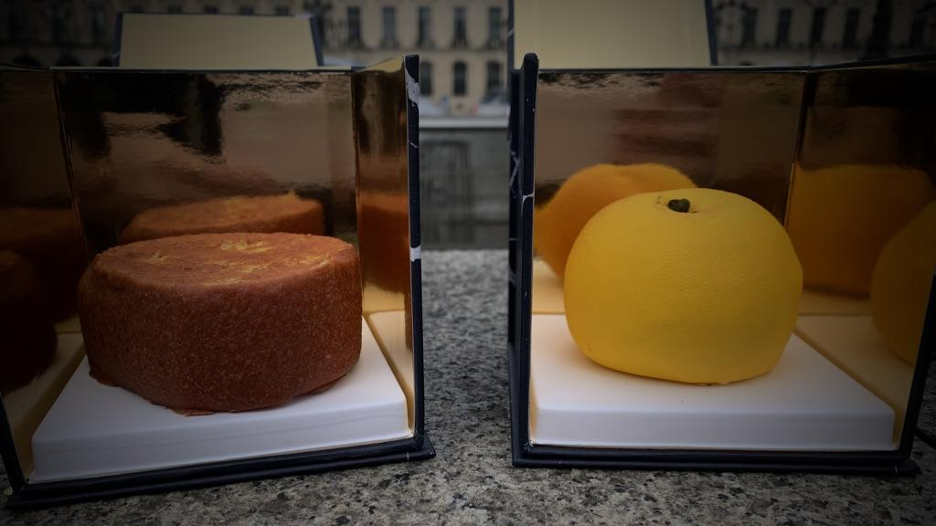
Results:
Consumers’ Opinions and Comparisons between France and the United States
04

Slide 15

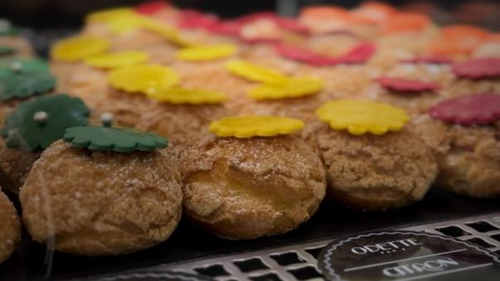
Parisian Consumers
in Paris
Parisian Consumers in the United States

Slide 16
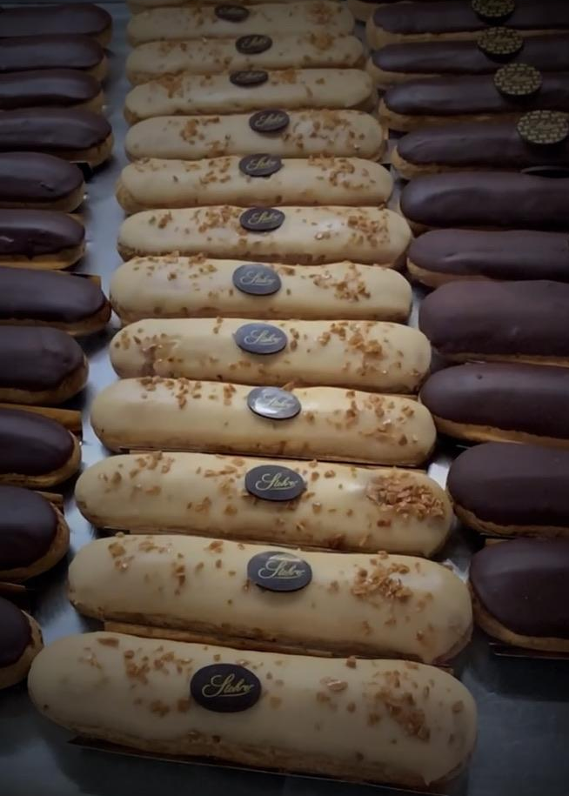
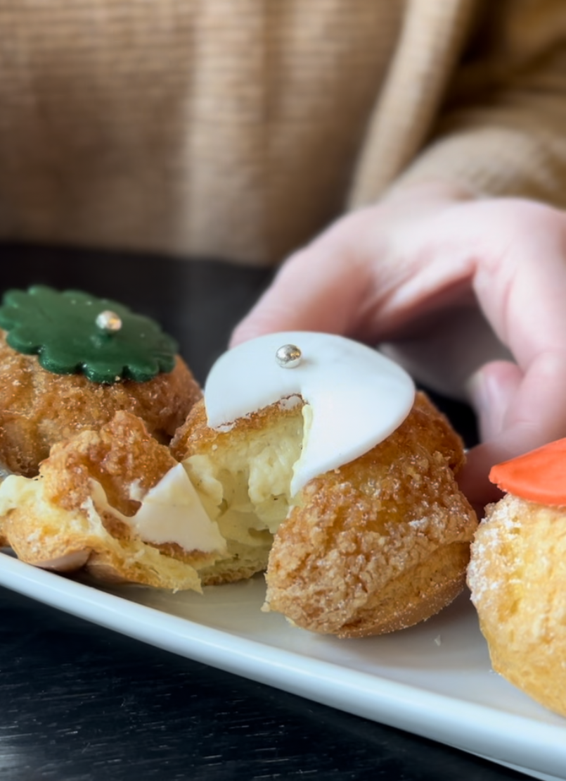
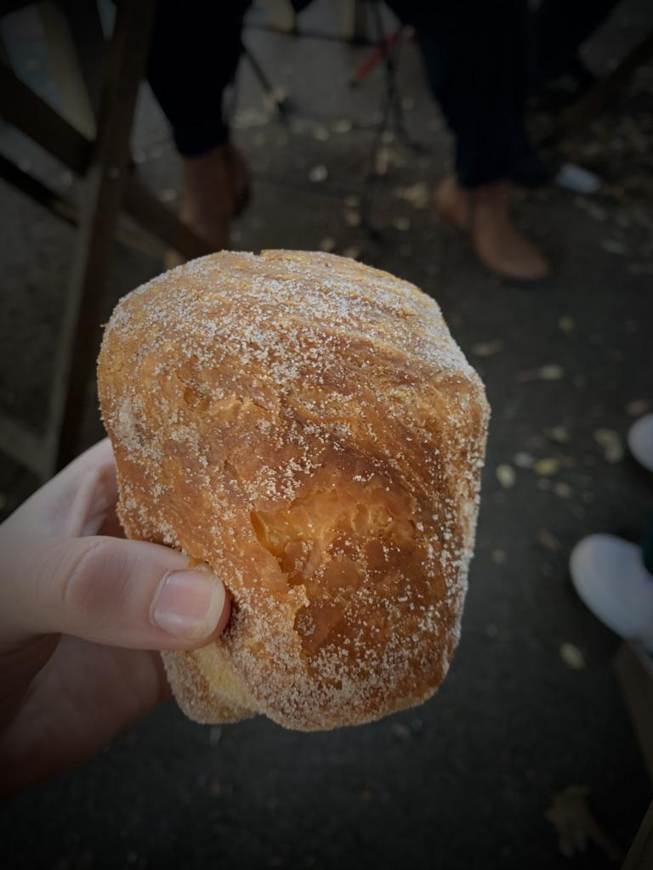
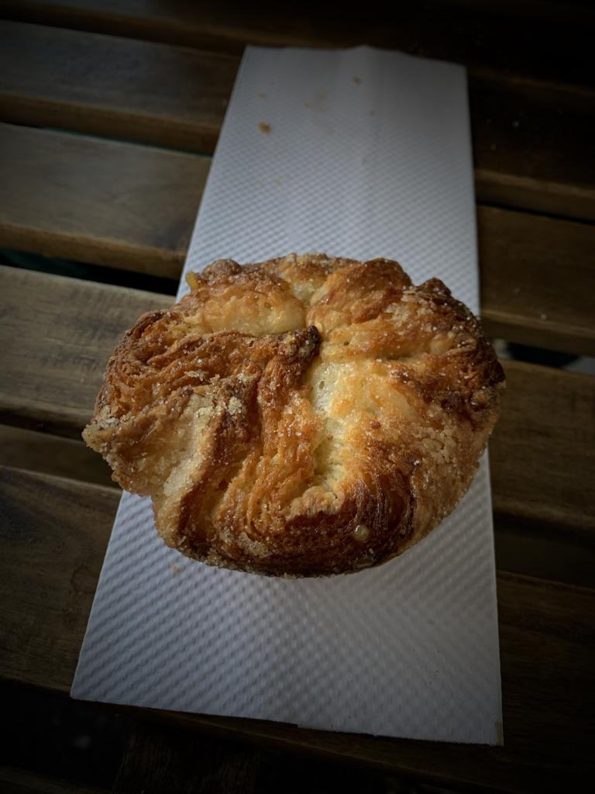
France
United States
Traditional techniques
Representative of national values
Basic expectation of quality due to regional and national relationship
Croissant hybrids
No deep cultural foundation of cuisine
Staged authenticity

Slide 17
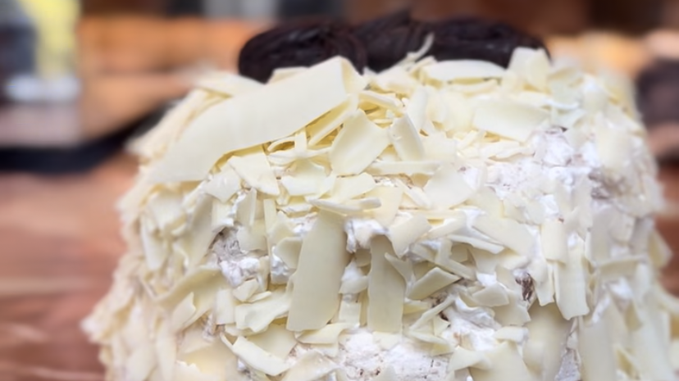
French Pastry Chef Perspectives
“I need to make sure I respect tradition and the way each dish has been created and lasting in France but at the same time we have a business to run and whatever needs to be done with no cheating and to make sure that the door keeps opening and there is money coming in no matter what my ideals are.”
“I mean I tend to agree with what you were saying about what brings Americans to French pastry shops is the…what’s not ordinary”
“You may be from a country with traditions that you want and need to respect but you are hosted by a new and different country. The respect you land for your own tradition have to coincide with the respect of traditions of the country you are decided to join.”

Slide 18

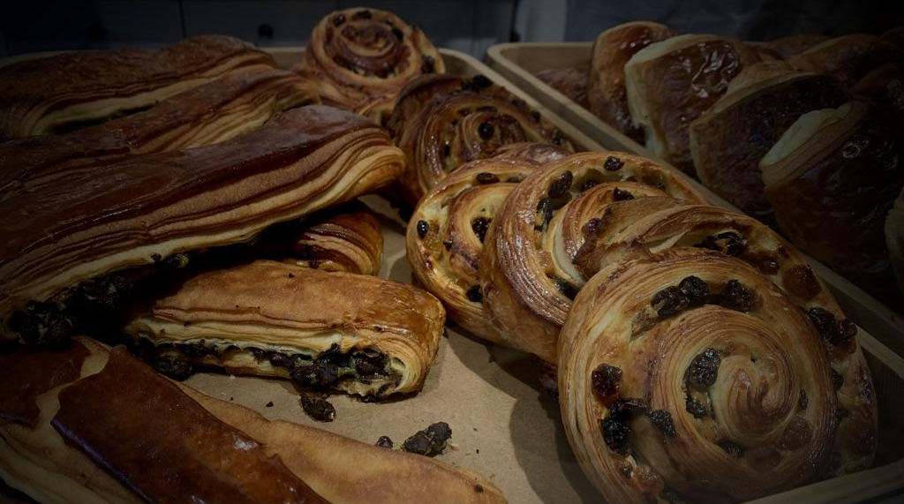
05
Conclusions

Slide 19

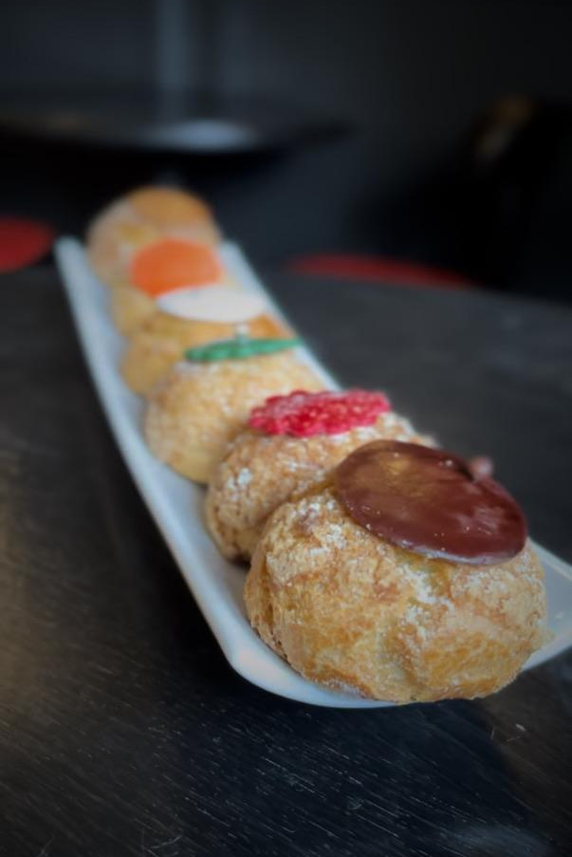
Contrasting cultural values in France and the United States affect the presentation and consumption patterns of French pastries created by French pastry chefs in Paris and in New York City.

Slide 20
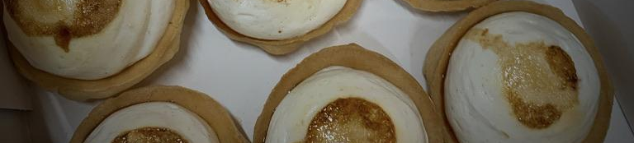
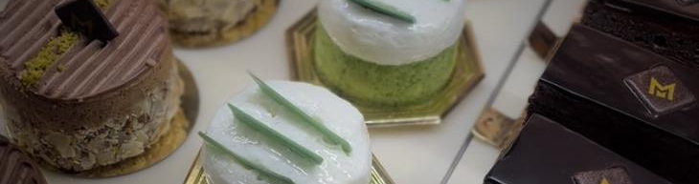

Q&A
Thank you!

Slide 21
Working Bibliography
Bavoillot, Ghislaine, ed. 2010. Paris Patisseries: History, Shops, Recipes. Translated by Carmella Abramowitz-Moreau. Flammarion.
Brillat-Savarin, Jean A. 2009. The Physiology of Taste: or Meditations on Transcendental Gastronomy. Edited by Mary Frances K. Fisher. Translated by Mary Frances K. Fisher. Alfred A. Knopf.
Ferguson, Priscilla P. 2004. Accounting for Taste: The Triumph of French Cuisine. University of Chicago Press.
Mintz, Sidney W. 1986. Sweetness and Power: The Place of Sugar in Modern History. Penguin Publishing Group.
Tebben, Maryann. 2015. “Seeing and Tasting: The Evolution of Dessert in French Gastronomy.” Gastronomica 15 (2): 10-25.
Wheaton, Barbara K. 1996. Savoring the Past: The French Kitchen and Table from 1300 to 1789. Scribner.

